Slide 1
Demystifying Data Science
Name: Robinson Muiru
Topcoder handle: Rokit12

Slide 2
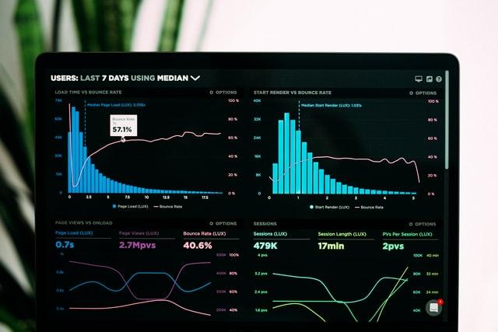
About the Content - Data Science
Overview -Introduction to data science
Understanding the technology
Project objective and skills
Tools
Market trends
Practice and Use cases

Slide 3
Overview
What is data science - Data science is a process that helps to develop blueprint to prepare data for analysis, analyze data, visualize data and explore data using modern tools, techniques e.t.c.
NB: Data scientist main job is to analyze data to get better user insights.

Slide 4
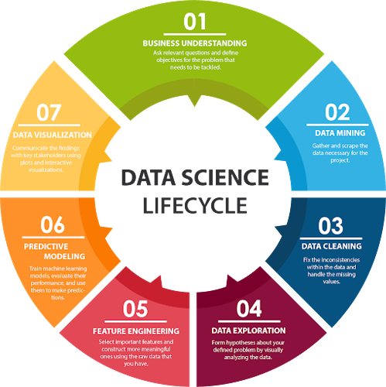
Data Science Cycle
Business Understanding
Data Mining
Data Cleaning
Data Exploration
5. Feature Engineering
6. Predictive Modeling
7. Data Visualization

Slide 5
Prerequisites for Data Science

Slide 6
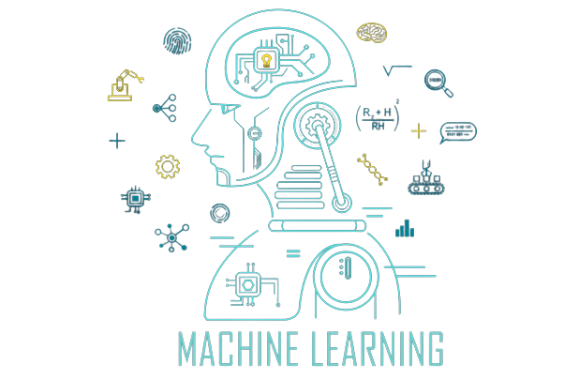
Machine Learning
Machine Learning - it is the study, the method of understanding and building techniques that help to utilize and manipulate data by using algorithms and statistical models.

Slide 7
2. Modeling
Modelling - is the mathematical calculation and prediction based on the leveraged data.
NB: Modelling is identifying the suitable algorithm to solve a problem mathematically.

Slide 8
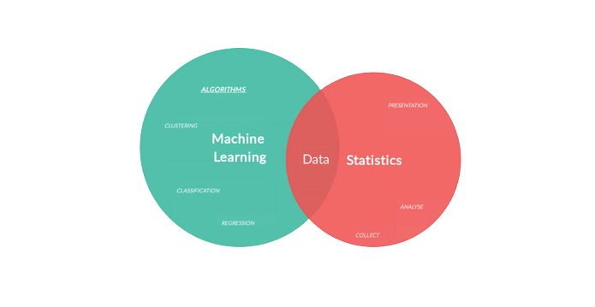
3. Statistics
Statistics - it is the core of data science that helps to generate data insights from a more intelligent techniques to get meaningful outcomes.

Slide 9
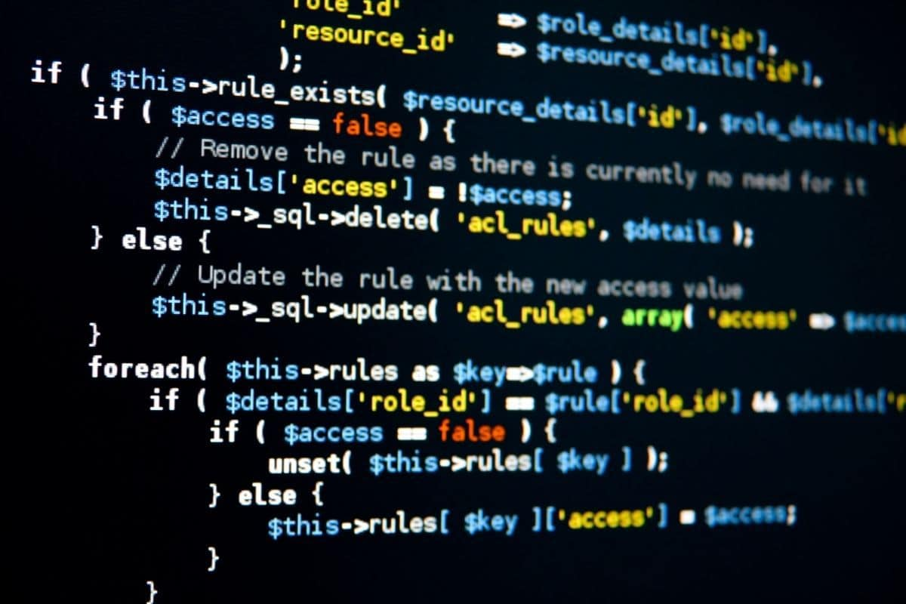
4. Programming
Programming - For data science and Machine Learning to work effectively, there are programming languages that offer support to libraries such as Python, R and e.t.c.

Slide 10
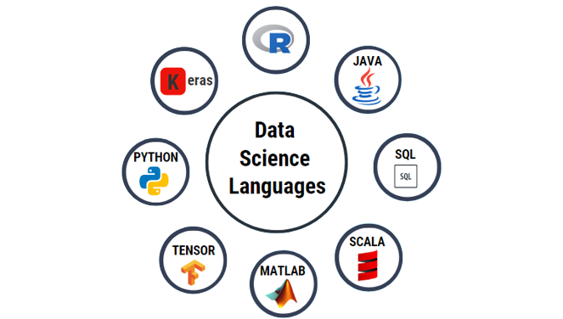
Programming Languages
& Tools

Slide 11
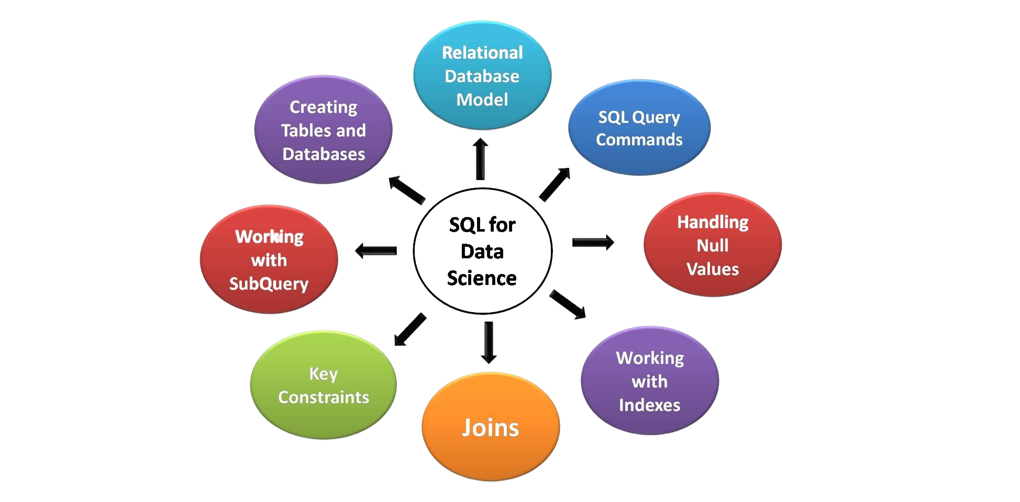
5. Databases
Databases - In data science the scientists is able to work with databases and understands how to manage and leverage the data used.

Slide 12
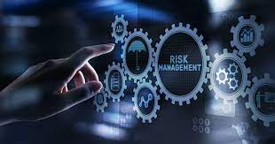
Overseers in Data Science process
IT Managers
Data Science Managers
Business Managers

Slide 13

Opportunities in Data Science
Data Engineer
Data Analyst
Data Scientist
Data Engineer
SUMMARY
Data Warehousing: Informatica, Talend, AWS Redshift
Data Visualization: Tableau, Cognos, RAW, Jupyter
Machine Learning: Mahout, Azure ML studio, Spark Mlib e.t.c
Data Analysis-: SAS, Jupyter, MATLAB, Excel

Slide 14

Use cases of Data Science
Healthcare
Logistics
Image
Recognition
Fraud
Detection
Speech
Recognition
Augmented
Reality
Advert
Recommendation
Gaming

Slide 15
Practice on Machine Learning
Using Python(on Jupyter notebook)
Libraries to use on this practice:
Numpy
Pandas
Matplotlib
Seaborn
NB: Install the libraries using pip package

Slide 16
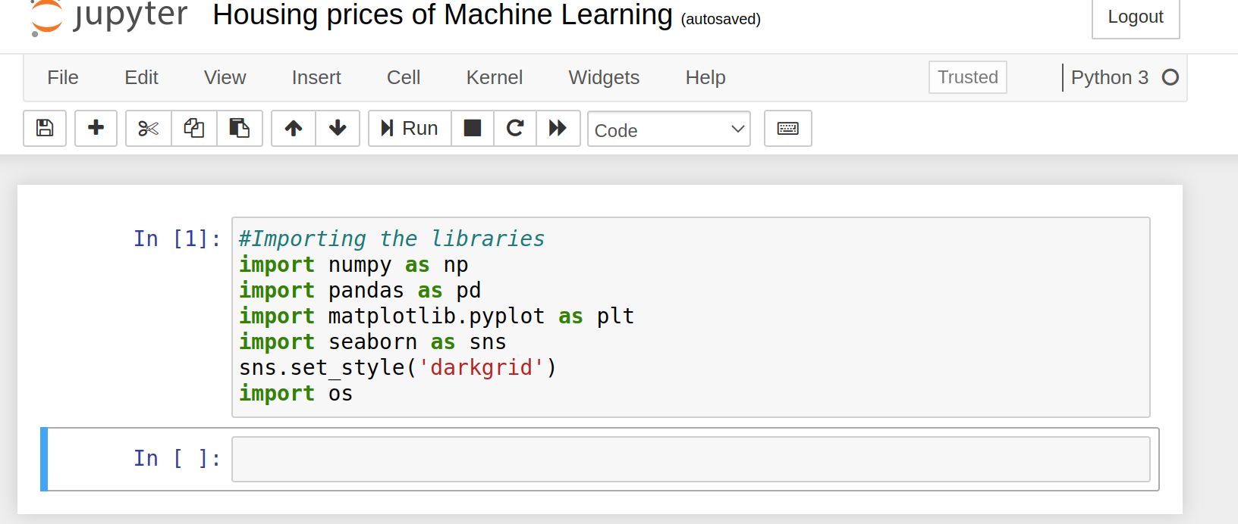
Import the libraries

Slide 17
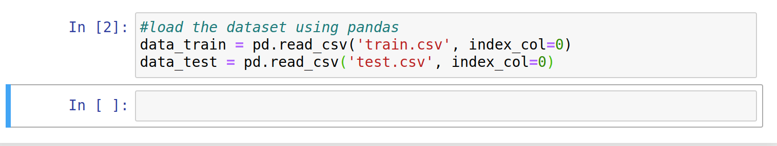
Load the data using pandas library

Slide 18
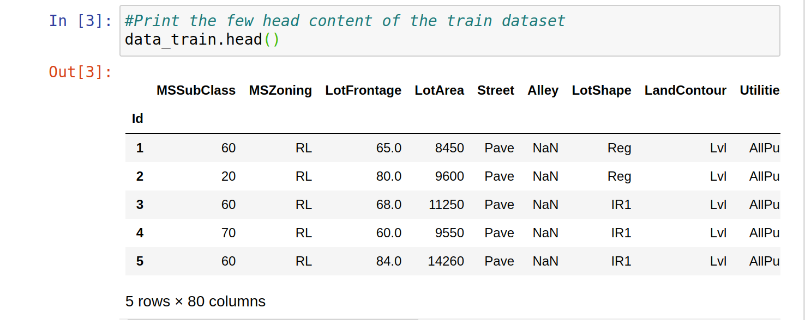
Get the few columns and rows in the dataset

Slide 19
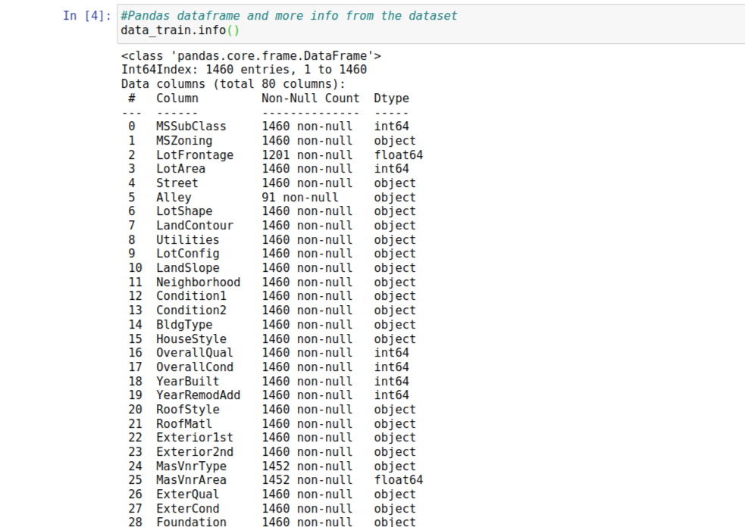
Panda dataframe information from the dataset

Slide 20
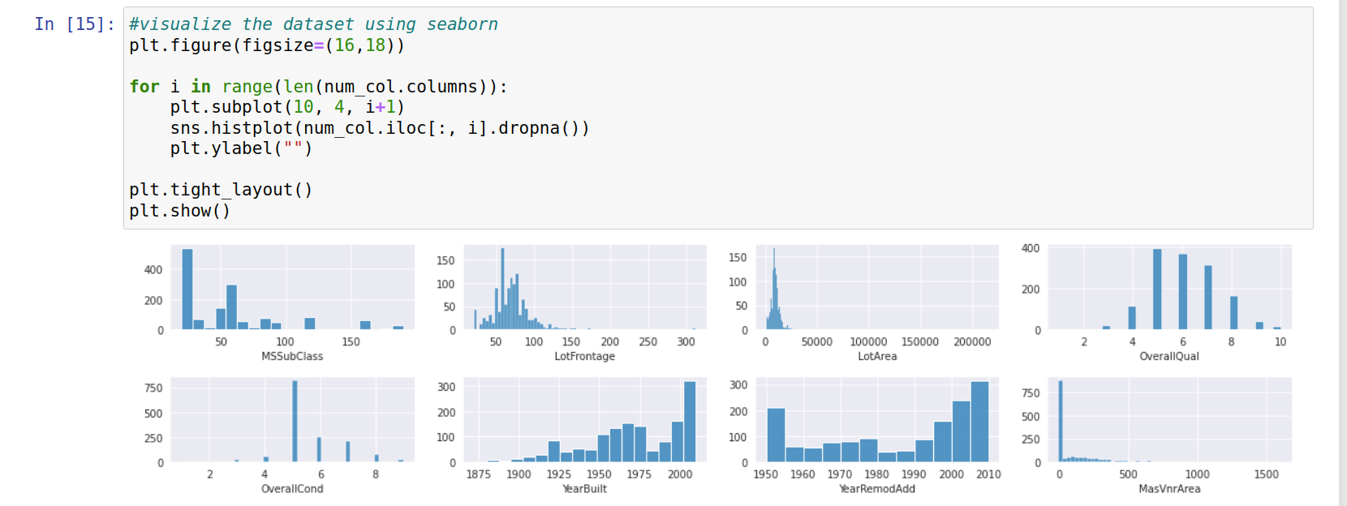
Data visualization

Slide 21
Extract the training data point

Slide 22
View more of these ML project via the link below:
Link:

Slide 23
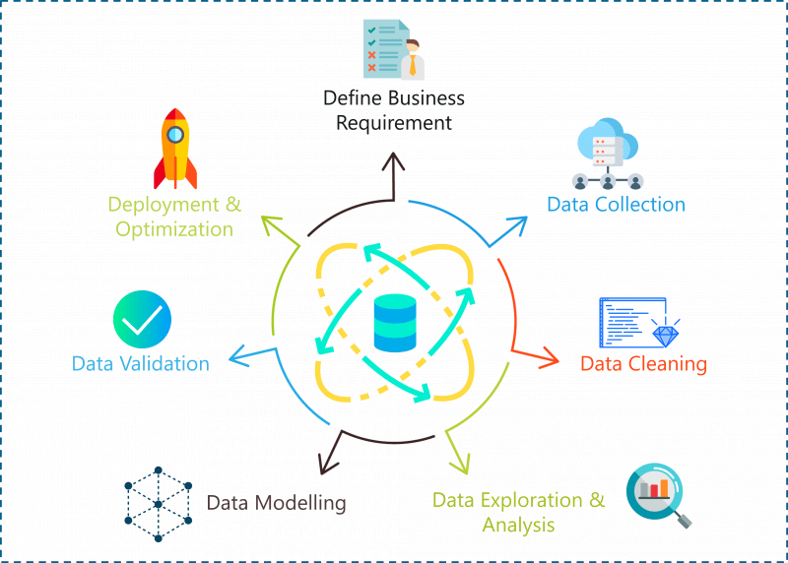
Thank you!

